Slide 1

Computer Programming for Engineers
Week 2 Lecture 2
Week 2 Lecture 2
Sep. 8, 2022
Lecturer: Mohammad Mahdi Javidan
College of Engineering, Sungkyunkwan University
Fall Semester 2022

Slide 2
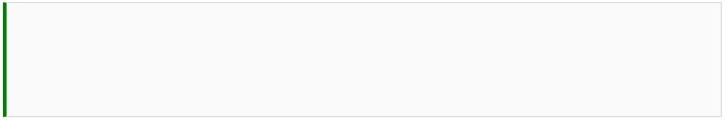

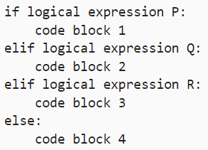
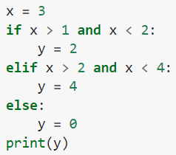
If-Else Statements
Simple If-Else Statement Syntax
Extended If-Else Statement Syntax
An example!
College of Engineering, Sungkyunkwan University

Slide 3
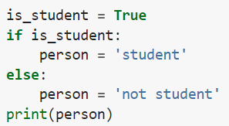

If-Else Statements
Ternary operator
College of Engineering, Sungkyunkwan University

Slide 4

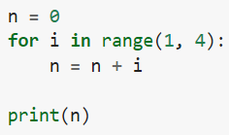


For Loops
It can be applied to other sequential data types like a tuple, string, etc.
College of Engineering, Sungkyunkwan University

Slide 5


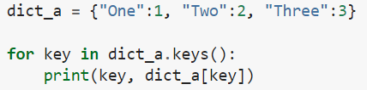

For Loops
Using the index
Looping through a dictionary
College of Engineering, Sungkyunkwan University

Slide 6

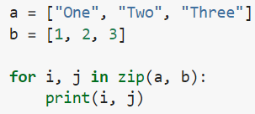

For Loops
Using the items method for dictionaries
Using two looping variables
College of Engineering, Sungkyunkwan University

Slide 7
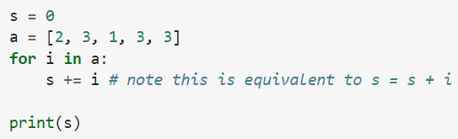

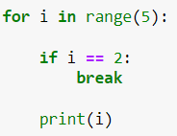
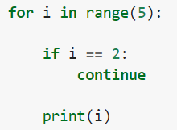


For Loops
Given a list of elements, add all its elements!
break and continue keywords
College of Engineering, Sungkyunkwan University

Slide 8
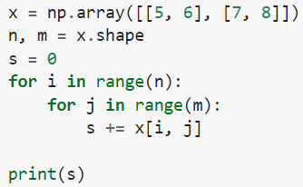

For Loops
Nested for loops
College of Engineering, Sungkyunkwan University

Slide 9

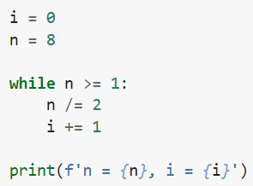


While Loops
Determine the number of times 8 can be divided by 2 until the result is less than 1
Infinite loop
Stop using:
ctrl+c on PC
cmd+c on Mac
College of Engineering, Sungkyunkwan University

Slide 10

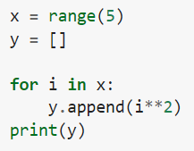



List Comprehension
A very compact way of doing iterations
If x = range(5), square each number in x, and store it in a list y
Using list comprehension
College of Engineering, Sungkyunkwan University

Slide 11


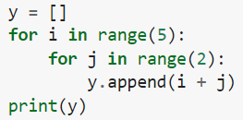


List Comprehension
Using conditions in list comprehension
Nested loops in comprehension list
College of Engineering, Sungkyunkwan University

Slide 12



Dictionary and Set Comprehension
Dictionary comprehension
It is also possible to do set comprehension
College of Engineering, Sungkyunkwan University

Slide 13
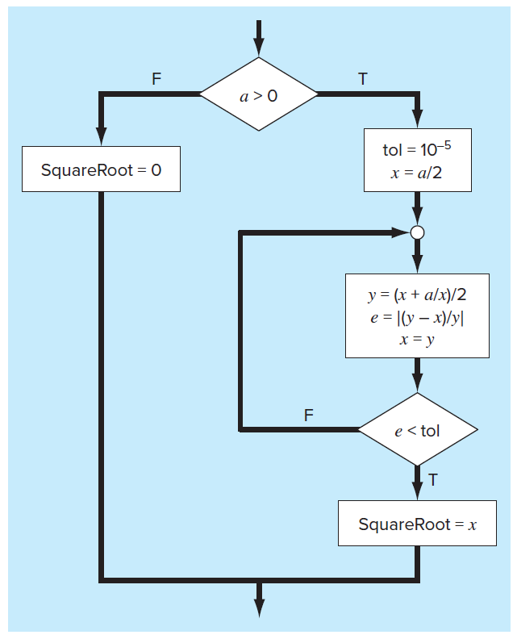
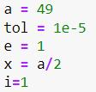
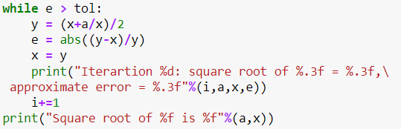
Square Root Program
Start
End
College of Engineering, Sungkyunkwan University

